Slide 1
Full Stack Web Development
Chrome Developer Tools

Slide 2
What Are Developer Tools?
Browser developer tools are used to test, examine & debug code
Provides access into the internals of the browser and web applications
NOT website builders
Come as either add-ons or built-in features
All modern browsers have built in tools now

Slide 3
Before Developer Tools
alert() calls
Minimal errors
Sometimes no line number or extra information
3rd Party Debuggers
Network Tools

Slide 4
Some Benefits
Full Console Logging
Edit Code in Real-Time
DOM Element Selecting
Optimize w/ Profilers
Powerful JavaScript debugger
Resource Viewers
Network & Analytics

Slide 5
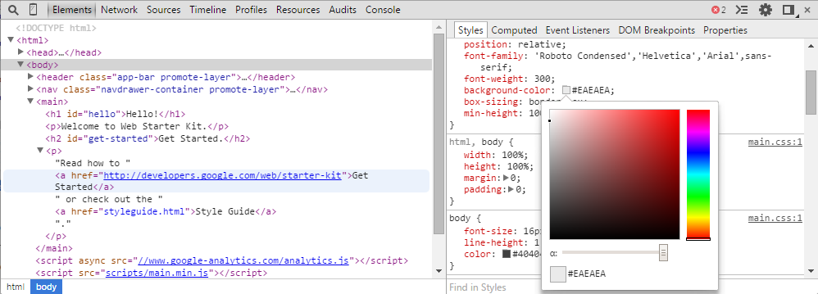
Inspecting & Editing Code
Add/remove HTML elements
Add/remove attributes
Add/remove CSS styles
Move elements around
Edit links
Search code

Slide 6
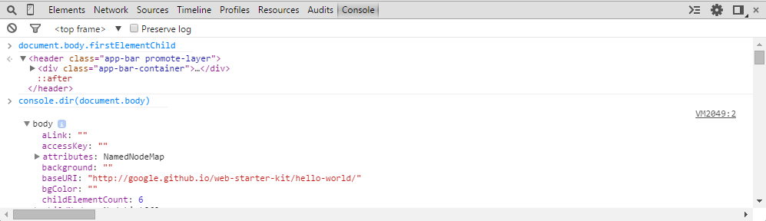
Working With The Console
Log diagnostic information
A shell prompt which can be used to interact with the document

Slide 7
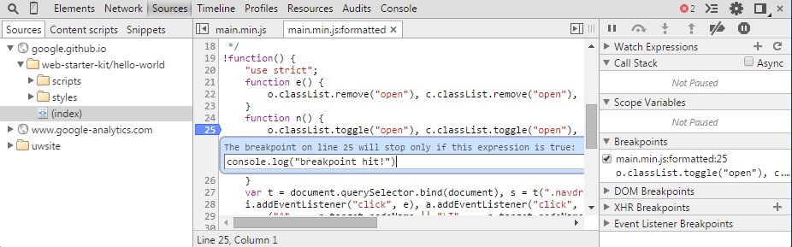
Debugging JS
Quickly discover the cause of the issue and fix it
Makes debugging MUCH less painful

Slide 8
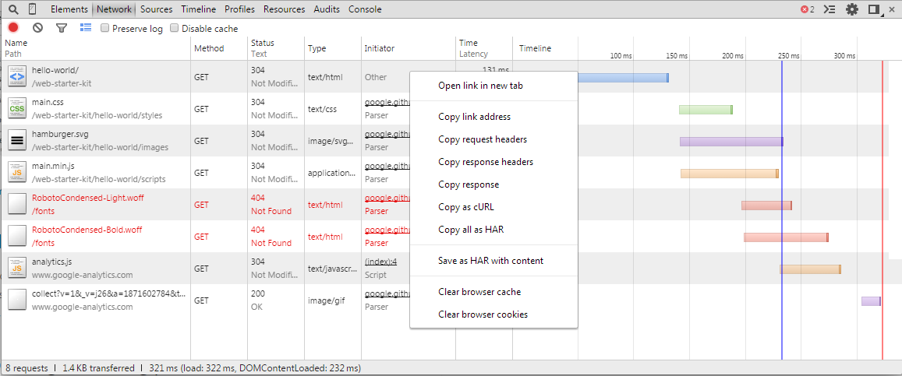
Improve Network Performance
Provides insight into resources that are requested and downloaded
Identify requests that take longer than expected and fix them
Helps optimize your webpage speed and reliability
ded

Slide 9
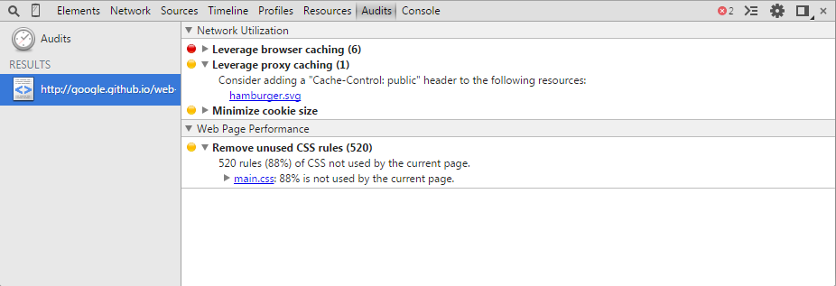
Audits
Analyze pages as they load
Provides suggestions and optimization for speeding things up

Slide 10
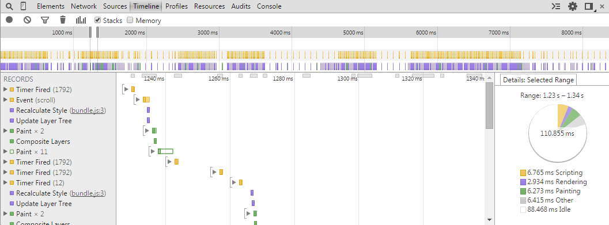
Improve Rendering Performance
See where most of the load time is being spent
Events are plotted on a timeline

Slide 11
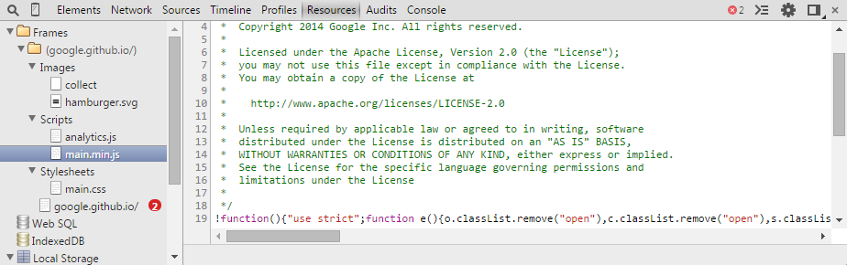
Storage Inspection
Inspect resources such as…
HTML5 Database
Local Storage
Session Storage
Cookies
AppCache
WebSQL
IndexedDB

Slide 12


